Slide 1
Task-Specific Joint Learning in Inverse Problems: Efficient Deep Unrolling networks and Bilevel Optimization Methods
By
Kadagala Sai Siva Sankar (20EC39017)
Electronics and Electrical Communicaton
Under the supervision of Prof. Subhadip Mukherjee

Slide 2
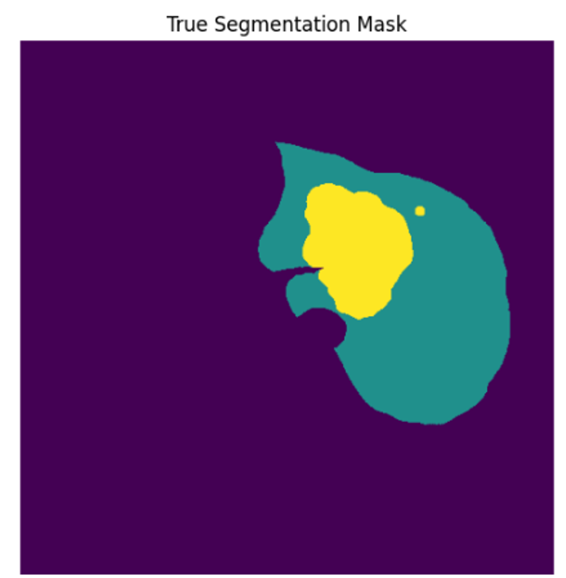
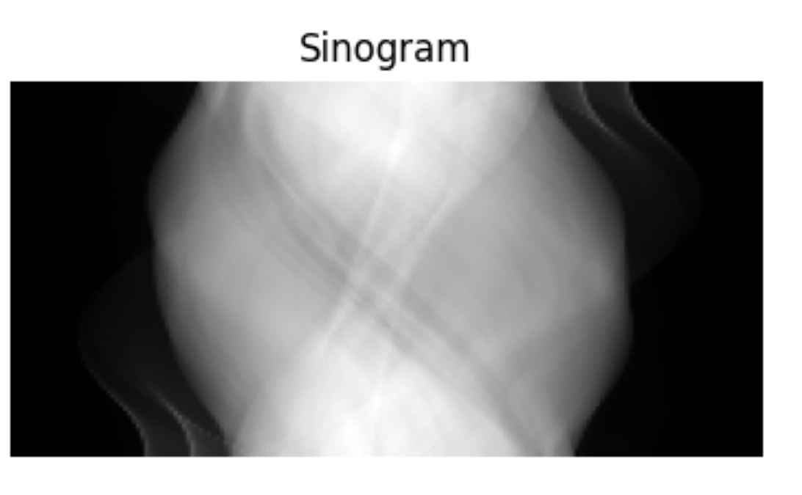
PROBLEM STATEMENT
GOAL : predict labels from noisy measurement data (Inverse problem) efficiently and accurately. (scalable too!)
In context of X-ray CT:

Slide 3
COMMON APPROACHES
Sequential: First reconstruct the images, then train a classifier on the reconstructed images. →Error Propagation!
End-to-End: This approach ignores the distinction between reconstruction and the task. →Data Hunger, Lack of Interpretability
Noisy images
Reconstruct
Train a classifier
Noisy images
Train a classifier using labels and noisy images

Slide 4
Task adapted reconstruction by Adler et. al
Core idea: Jointly optimize reconstruction and task-specific loss functions in a single, end-to-end learning process.
Loss = C* Reconstruction loss + (1-C)* Task loss

Slide 5
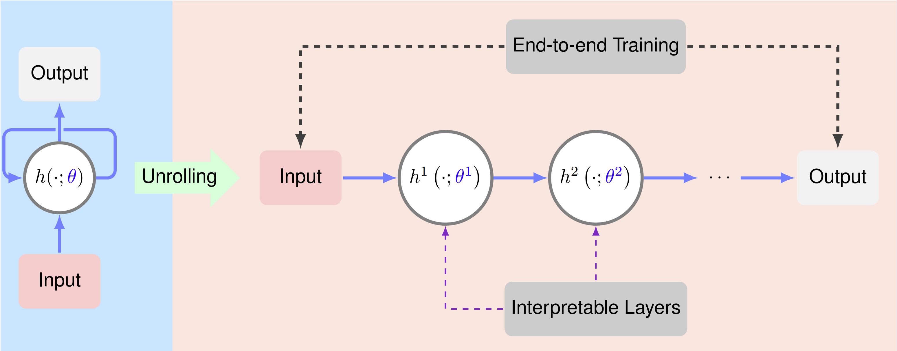
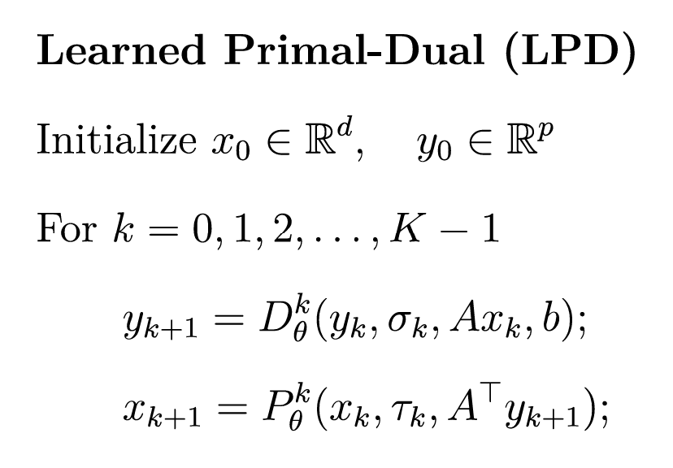
Deep Unrolling networks
Deep networks are hindered by their Blackbox nature, i.e., lack of interpretability.
Source: Algorithm Unrolling: Interpretable, Efficient Deep Learning for Signal and Image Processing Monga et al. ,2020
X → Primal variable
Y → Dual variable

Slide 6
Efficient Unrolling Networks
But, in real-world clinical CT applications:
→Reconstruction of a 3D volume is essential
→Computationally expensive
Replace the forward and adjoint operators in the full-batch LPD network with only subsets of it.

Slide 7
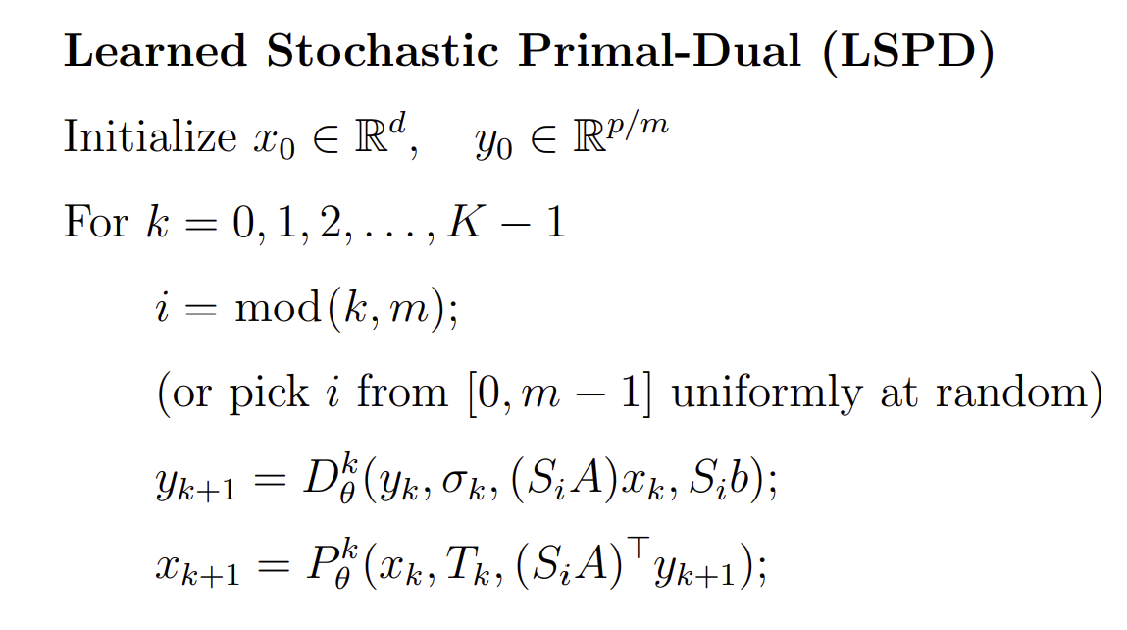
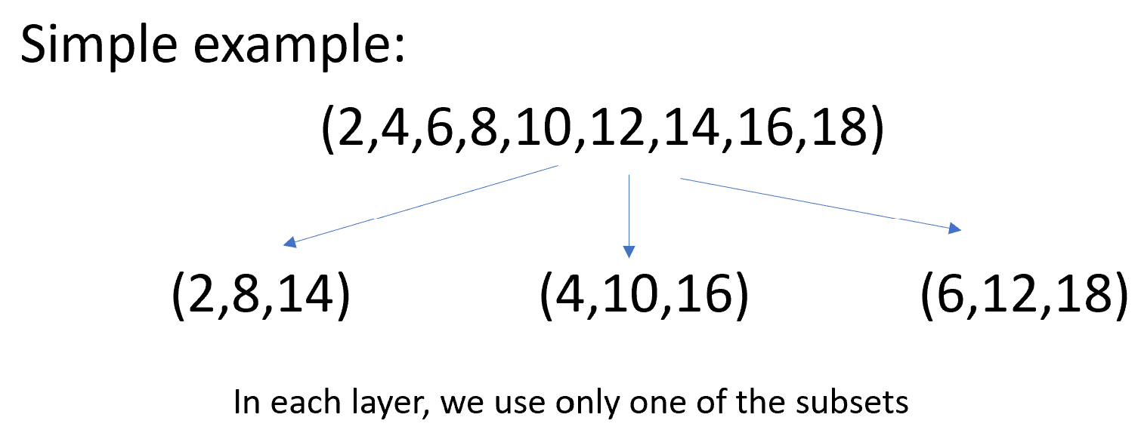
Replace the forward and adjoint operators in the full-batch LPD network with only subsets of it.
For the same number of layers, the LSPD network is approximately m-time more efficient than the full-batch LPD network in terms of computational complexity

Slide 8
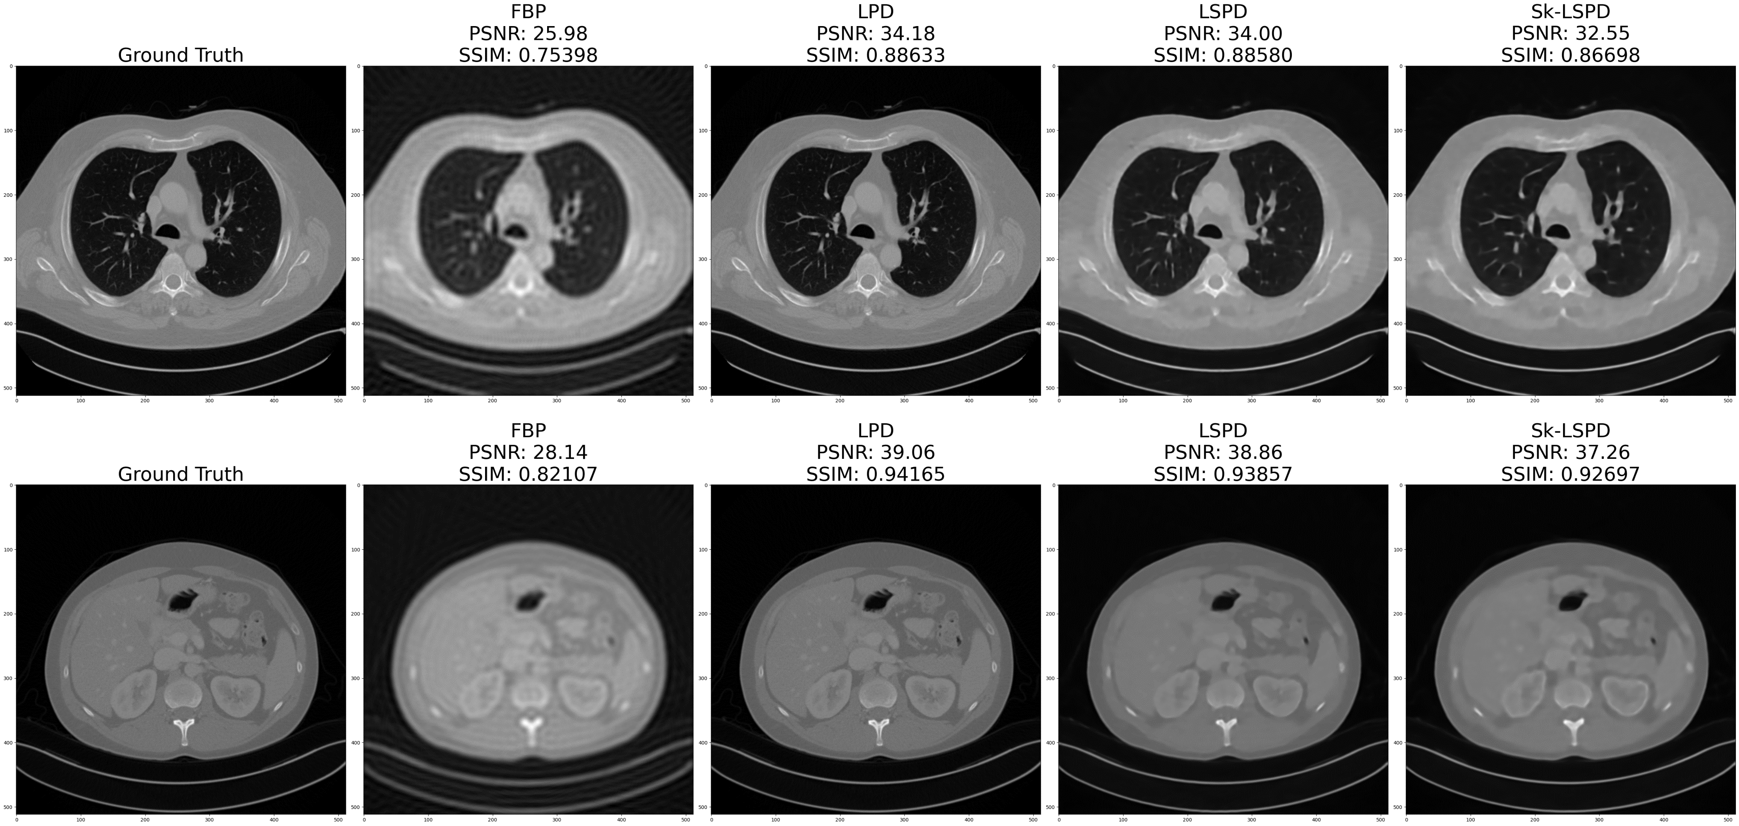
Experiment: Learned Stochastic Primal Dual (LSPD) and Sketched-LSPD on Mayo-Clinic dataset

Slide 9
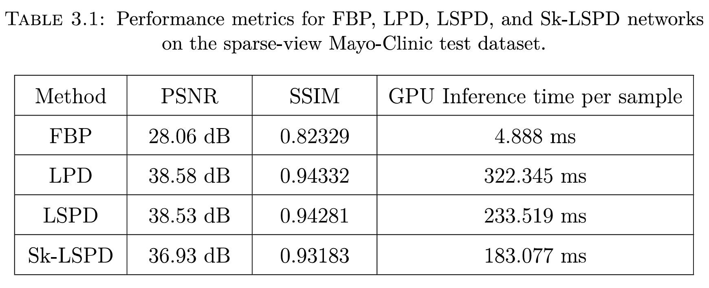

Slide 10
Task adapted reconstruction by Adler et. al
Core idea: Jointly optimize reconstruction and task-specific loss functions in a single, end-to-end learning process.
Loss = C* Reconstruction loss + (1-C)* Task loss
Existing work: use LPD network for recons and UNET for segmentation task.
Our work: replace LPD network with LSPD (for computational efficiency with slight performance tradeoff)

Slide 11
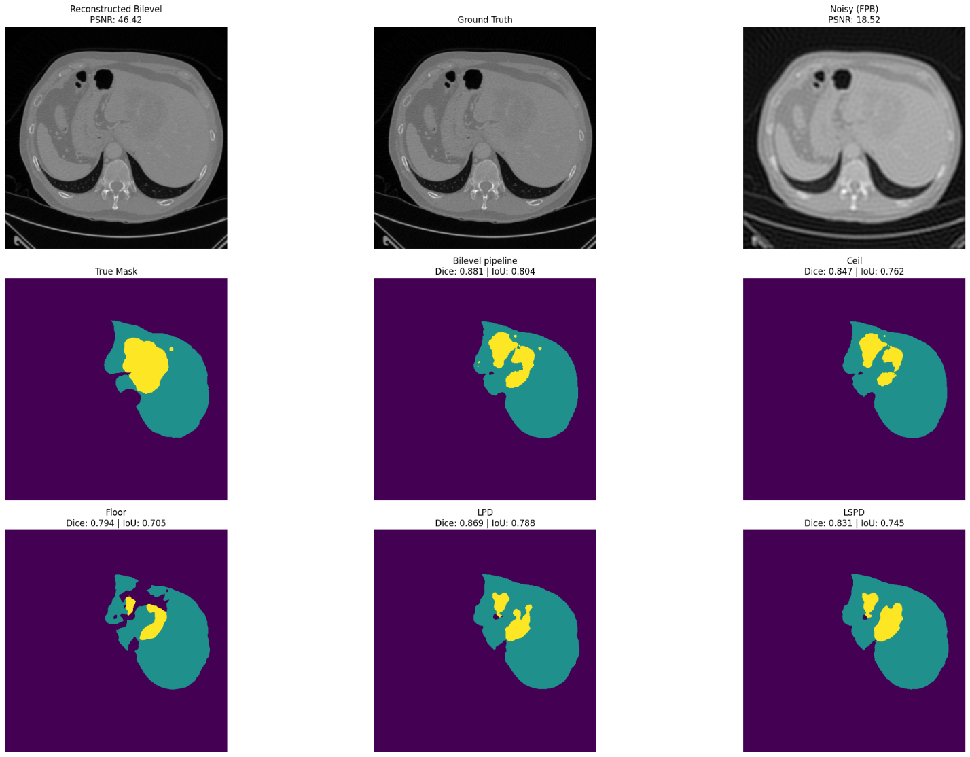

Slide 12
Bilevel Pipeline
The joint learning approach lacks:
Mathematical flexibility.
Cannot separate reconstruction and task into separate optimizations.
Bilevel: separates the reconstruction and task objectives into a nested optimization structure.

Slide 13
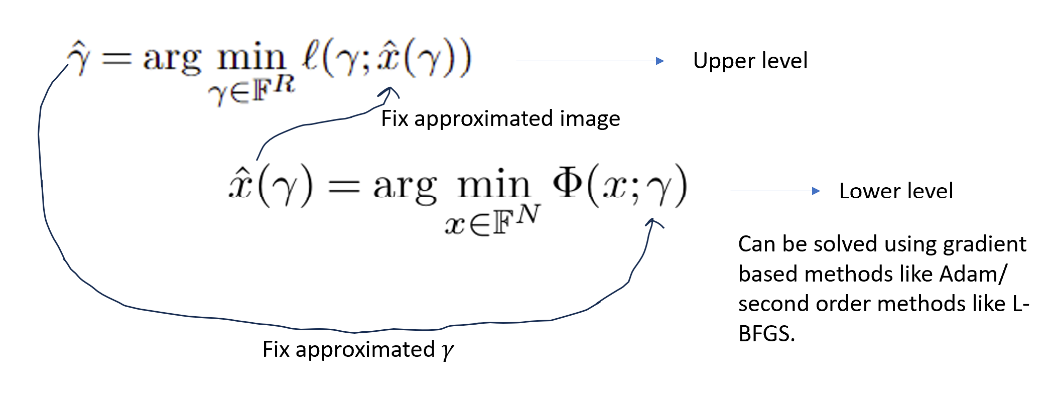
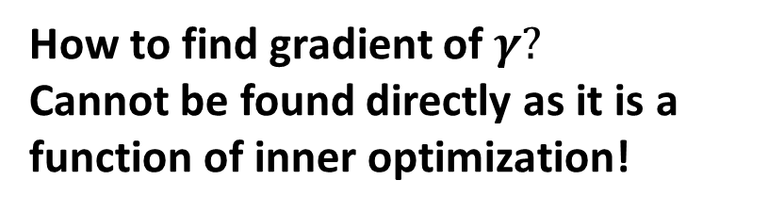
How to find gradient of $γ?$
Cannot be found directly as it is a function of inner optimization!
Task loss
Reconstruction loss

Slide 14
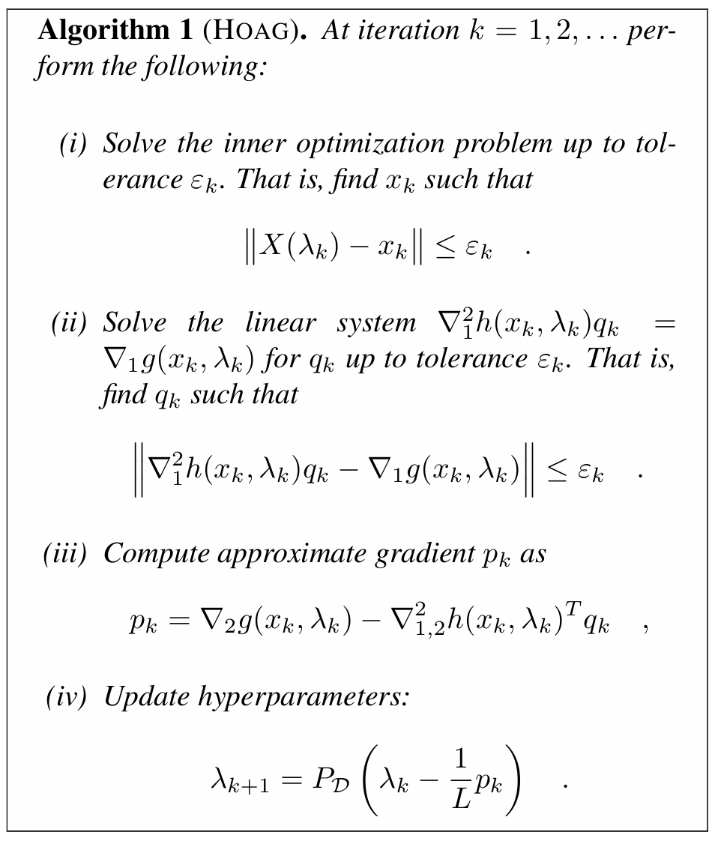
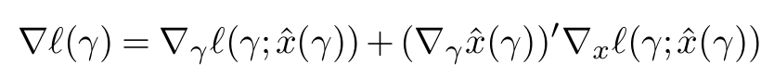
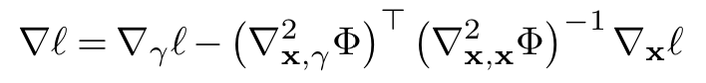
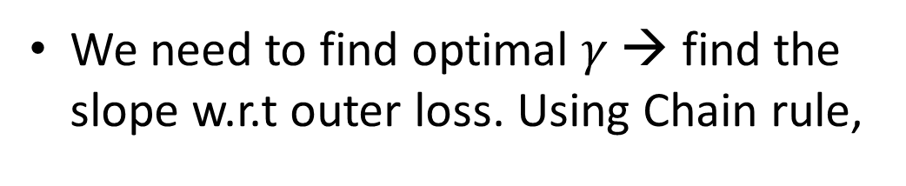
Hyperparameter Optimization with Approximate Gradient algorithm (HOAG)
We need to find optimal $γ$ → find the slope w.r.t outer loss. Using Chain rule,
Can be derived using implicit Differentiation.
More on this in the report!
Source: Hyperparameter optimization with approximate gradient by Fabian Pedregosa

Slide 15
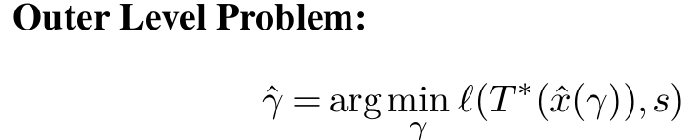
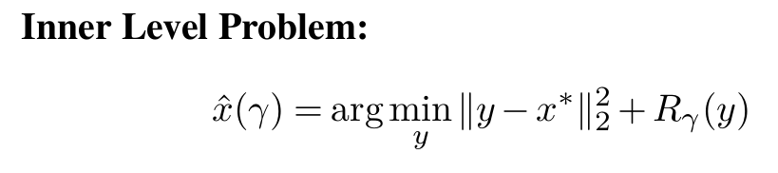
Proposed: Bilevel Joint learning pipeline
T* → pretrained task operator trained on the clean dataset.
Dataset → (x*, y, s) | x* →ground truth | y → noisy measurements | s → task labels.

Slide 16
EXPERIMENTS for proof of concept Segmentation Classification

Slide 17
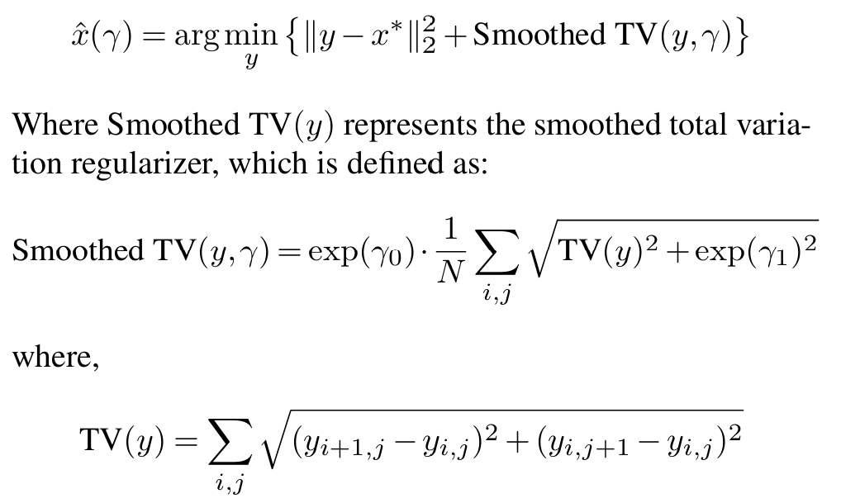
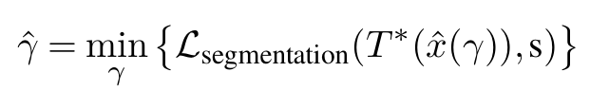
Image denoising and segmentation using Cityscapes Dataset
Lower-level optimization:
Upper-level optimization

Slide 18
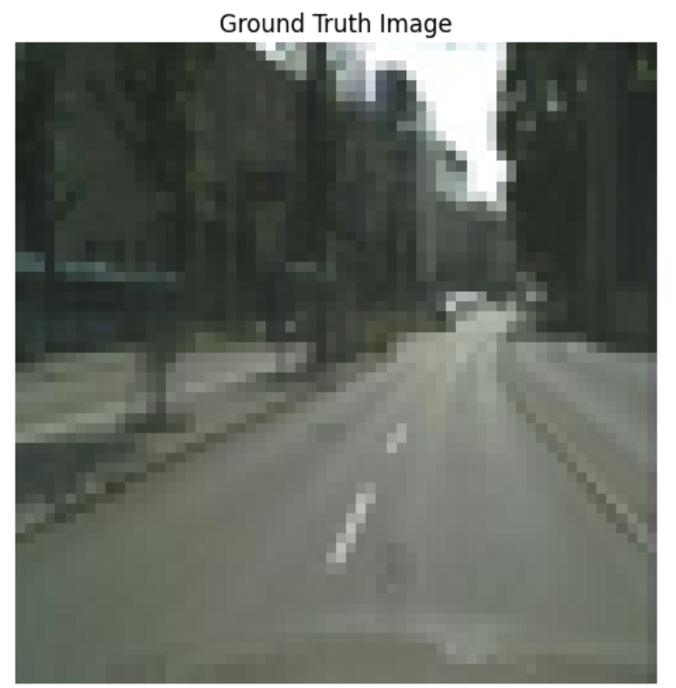
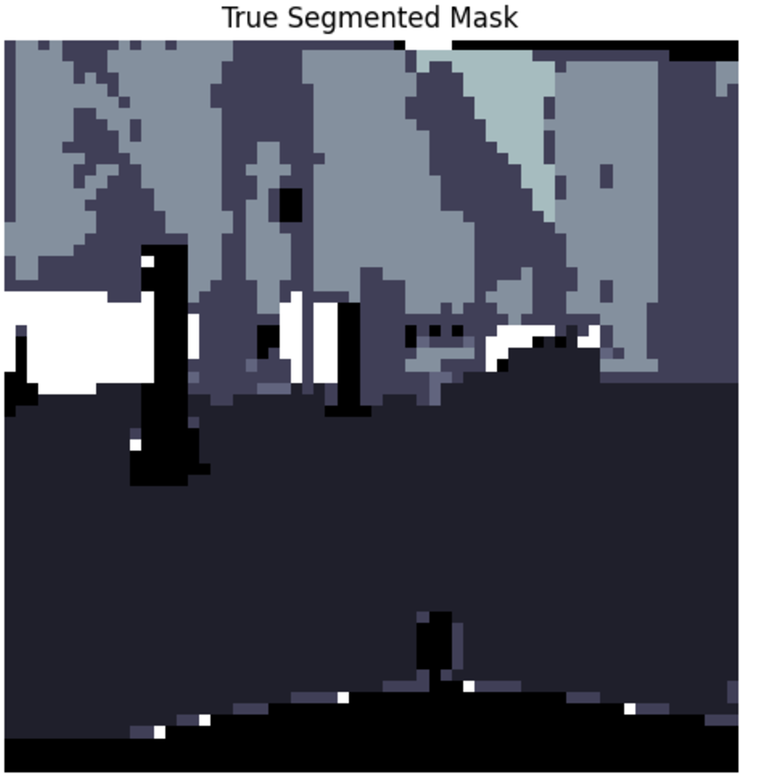
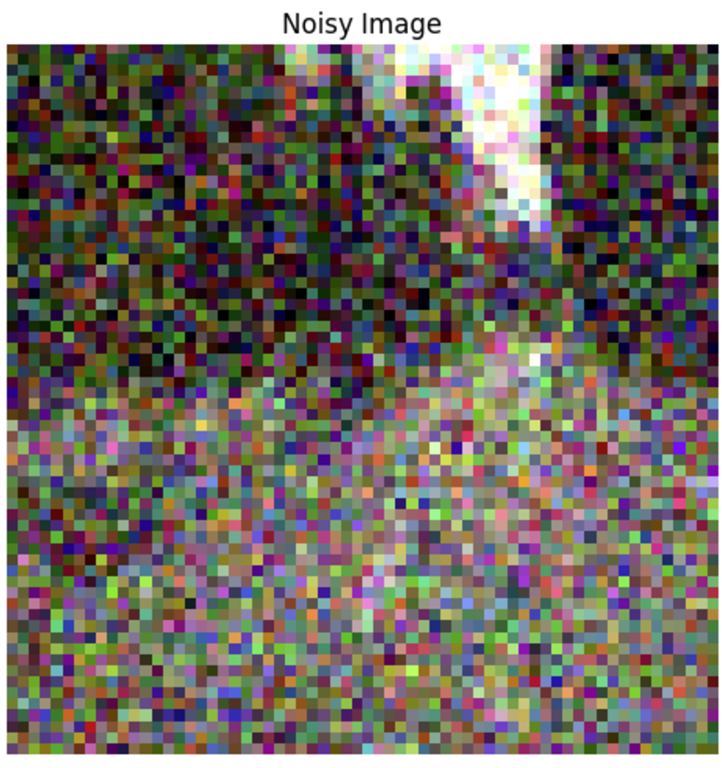
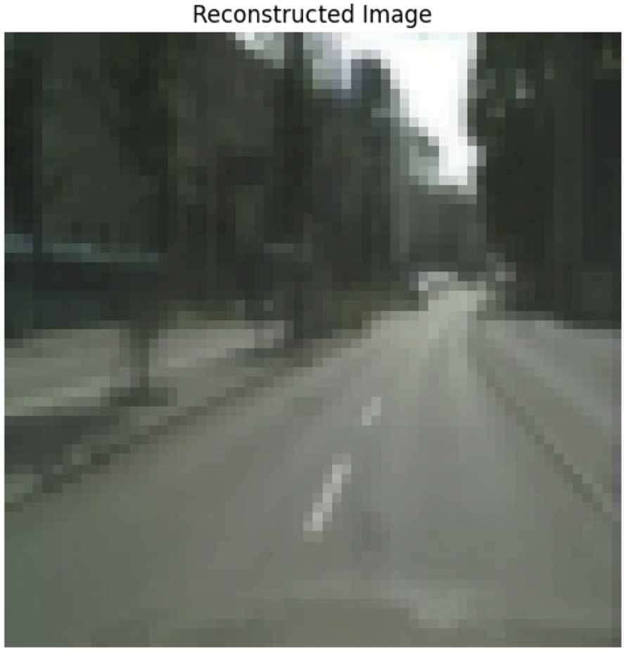
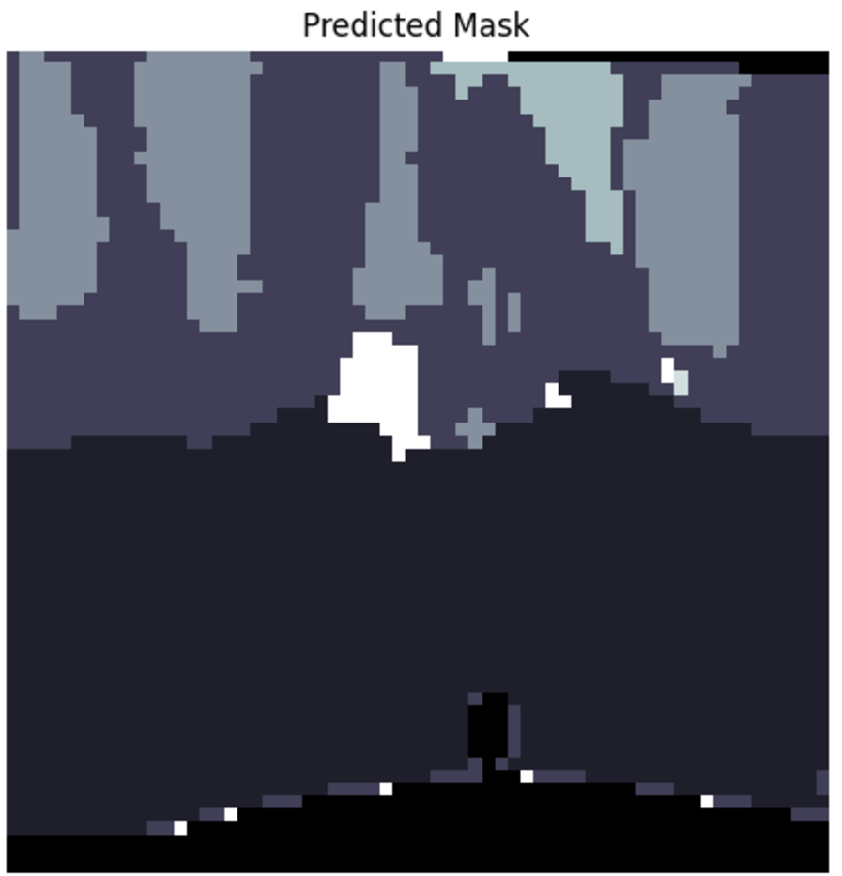

Slide 19
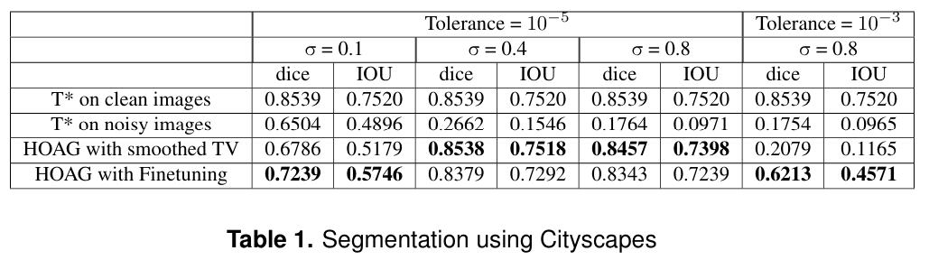
Results

Slide 20
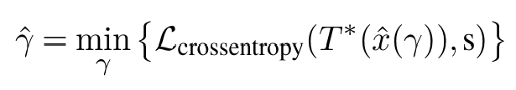
Image denoising and classification using Stanford Dogs Dataset.
Upper level
Lower level is same as previous experiment.

Slide 21
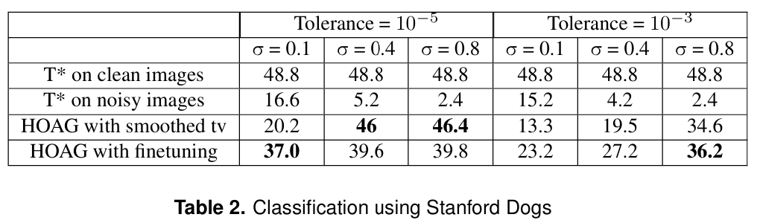
Results

Slide 22
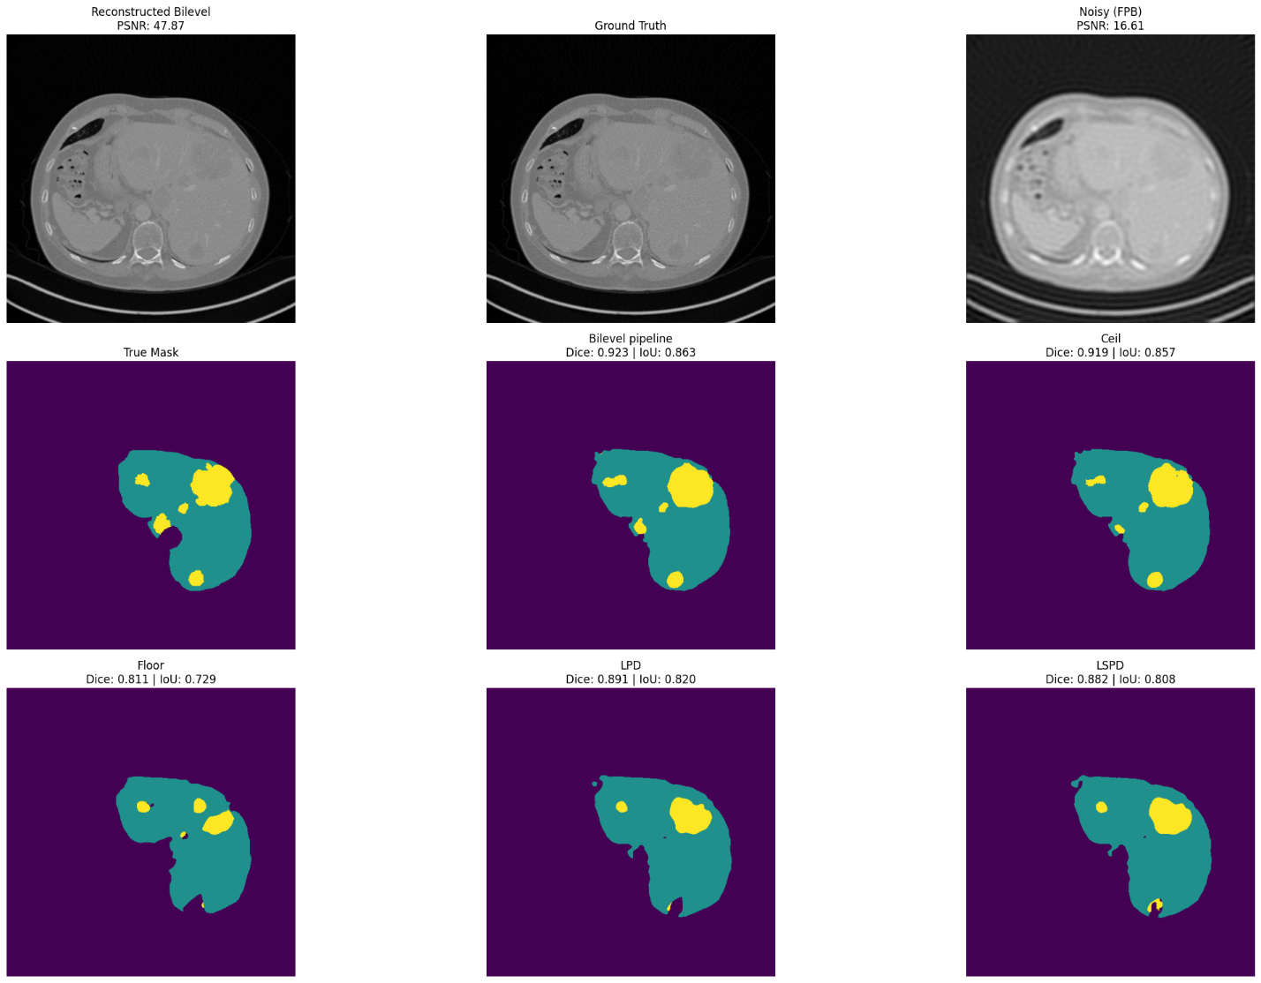

Slide 23
Possible Future Directions
Future Enhancements: Incorporate neural networks as regularizers for flexibility and explore robust bilevel optimization algorithms for efficiency.
Make Bilevel Pipelines more efficient to scale it up to 3D.
Combine both unrolling networks and Bilevel Pipelines.
Generalizable Pipeline: Aim to create a flexible framework where only task-specific losses are required, enabling broad applicability.

